Slide 1
Introduction to R Workshop
Megan Stachura
January 14, 2015

Slide 2

What is R?
R is a language and environment for statistical computing, graphics and much more
It is an open source (free) project which is similar to the S language and environment

Slide 3
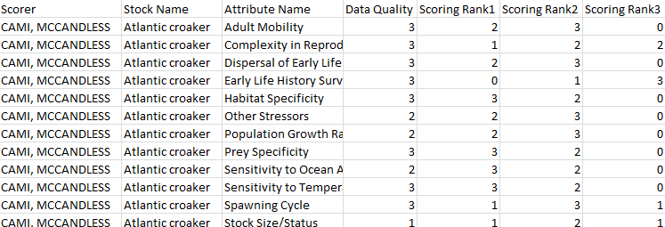
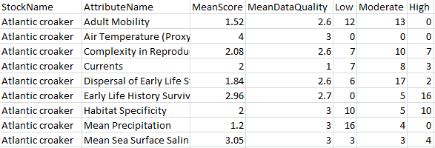
What can R do? Data Handling
Data handling and storage
Can import large amounts of data and apply functions across the data quickly
Raw Data
Data ready for plotting and analysis: counts and averages across scorers

Slide 4
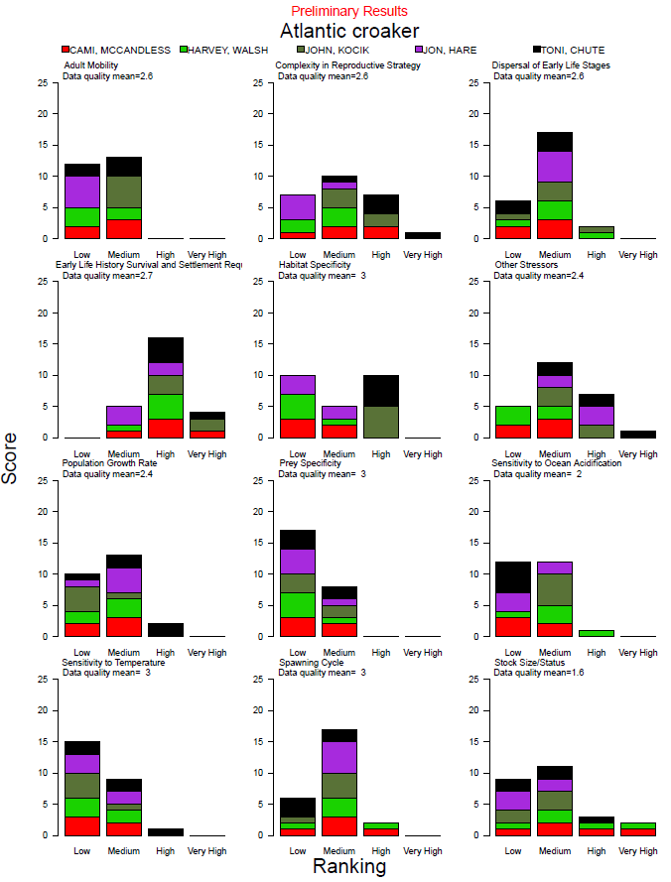
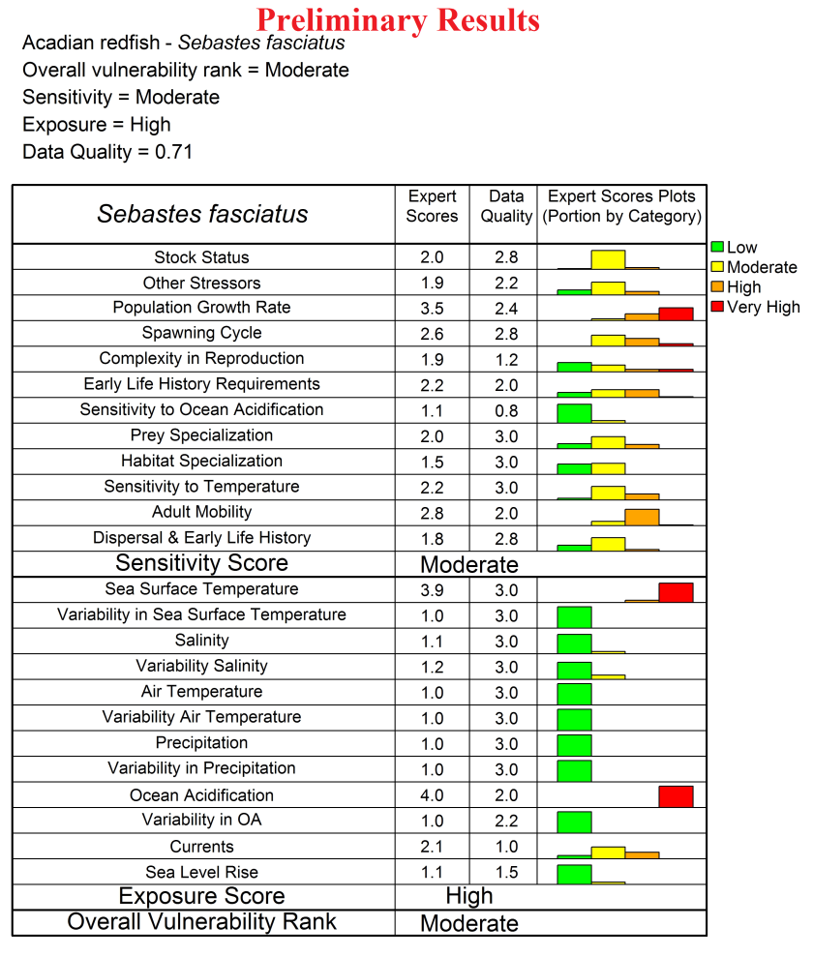
What can R do? Graphics
Graphics for data analysis and display
Can produce publication quality graphics
Can control everything about the plot

Slide 5
What can R do? Statistical Analysis
R provides a comprehensive set of statistical analysis techniques
Classical statistical tests
Linear and nonlinear modeling
Time-series analysis
Classification & cluster analysis
Spatial statistics
Bayesian statistics
. . . . any statistical technique you use is likely built into R or a user contributed package

Slide 6
Learning R
Just like with other computing languages, the initial learning curve can be steep, but there are lots of help files, online sources, books and teachers
Be patient and creative!
Notes:
6

Slide 7
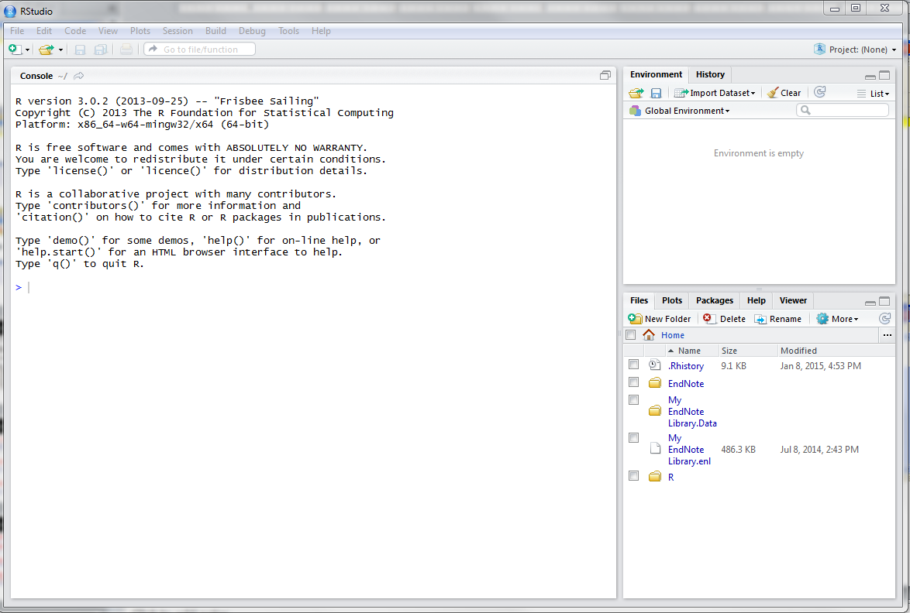
Orientation to RStudio

Slide 8
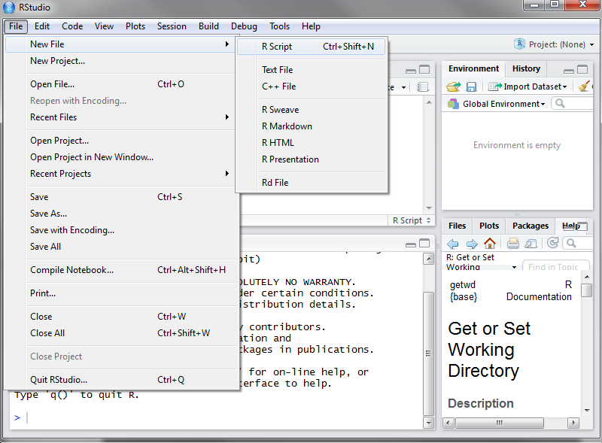
Orientation to RStudio: Open a New Script
File > New File > R script

Slide 9
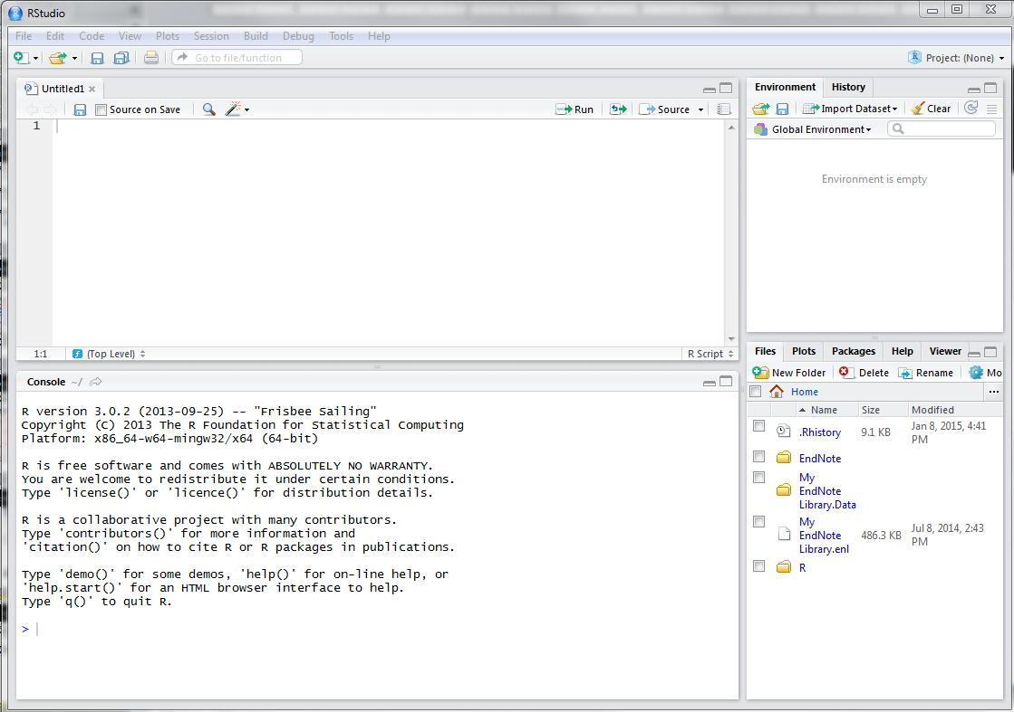
Orientation to RStudio
Script- where you write your code
Environment- information saved in memory (eg variables)
Plots, help, packages
R console- where your code is run

Slide 10
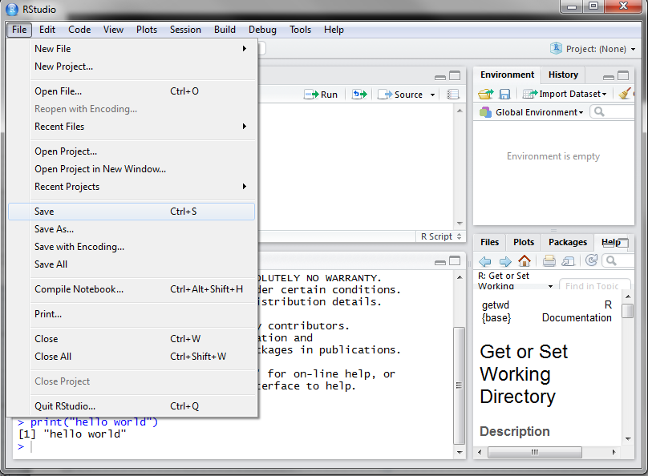
Orientation to RStudio: Save Your Script
File > Save As
Use a meaningful file name
All scripts should have the *.R extension
eg: RIntroWorkshop.R

Slide 11
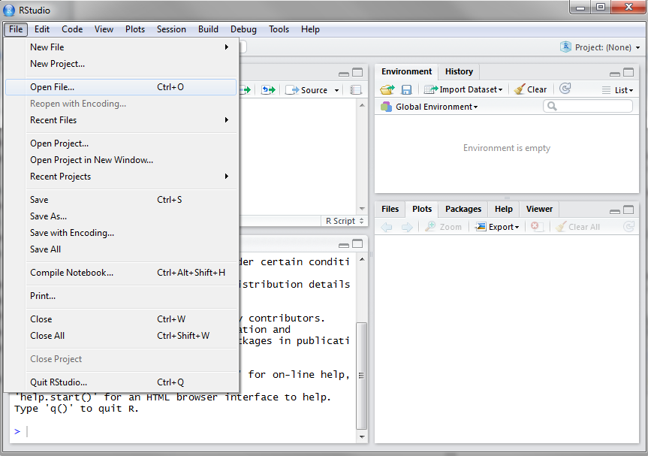
Orientation to RStudio: Open Saved Script
File > Open File > Navigate to script I sent out

Slide 12
Comments
Use comments to document the intention of the code
The # sign denotes a comment. All subsequent entries are not interpreted by R
# This is a comment
Rule of thumb
Document the why not the what (i.e. intent, purpose)
Use good names instead of just relying on comments
Do not use comments that repeat the code
Don’t assume you will remember anything about the code when you look at it later

Slide 13
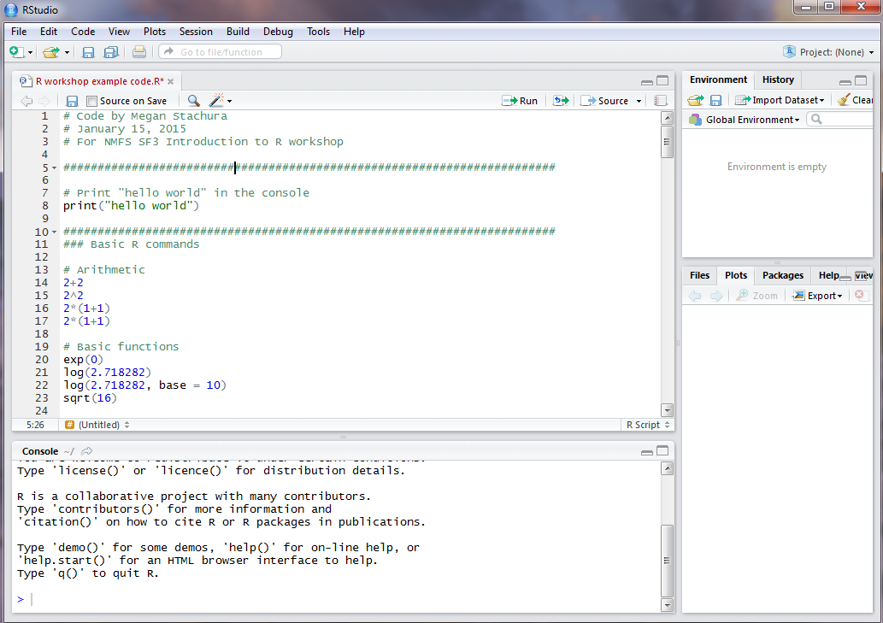
Comments

Slide 14
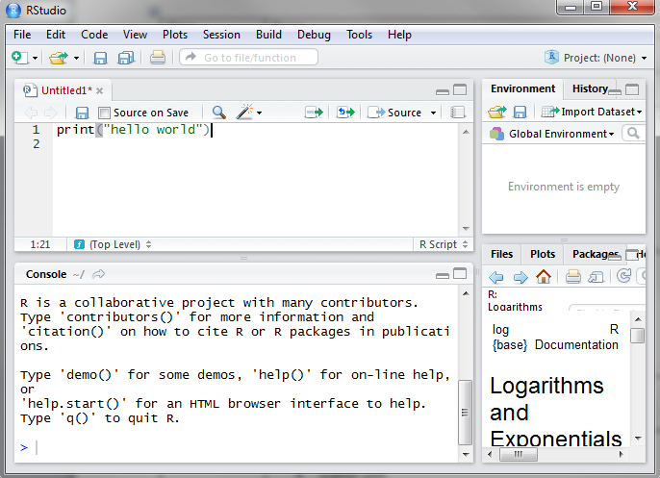
Writing a line of code
Type into the R script
print(“hello world”)
Font for code throughout presentation

Slide 15
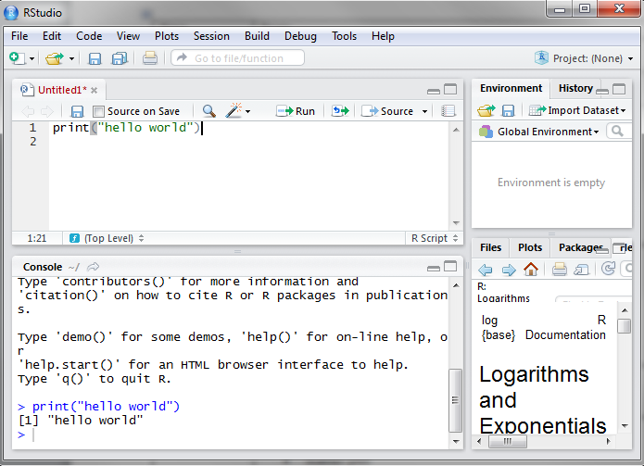
Running a Line of Code
Highlight the code or put your cursor anywhere on the line
Press the “Run” button or use the shortcut CTRL+ENTER
Can also highlight a chunk of code and then run

Slide 16
Basic R Commands
> 2+2
[1] 4
> 2^2
[1] 4
> 2*1+1
[1] 3
> 2*(1+1)
[1] 4
Command
Result
Ordering is important

Slide 17
Basic R Commands
> exp(0)
[1] 1
> log(2.718282)
[1] 1
> log(2.718282, base = 10)
[1] 0.4342945
> sqrt(16)
[1] 4
Optional argument
Default value is e or 2.718

Slide 18
Exercise 1
Use R to compute the following
1 + 2(3 + 4)
log(4³ + 3²⁺¹)

Slide 19
Exercise 1
Use R to compute the following
1 + 2(3 + 4)
log(4³ + 3²⁺¹)
> 1+(2*(3+4))
[1] 15
> log((4^3+3^(2+1)), base = 10)
[1] 1.959041
> sqrt((4+3)*(2+1))
[1] 4.582576

Slide 20
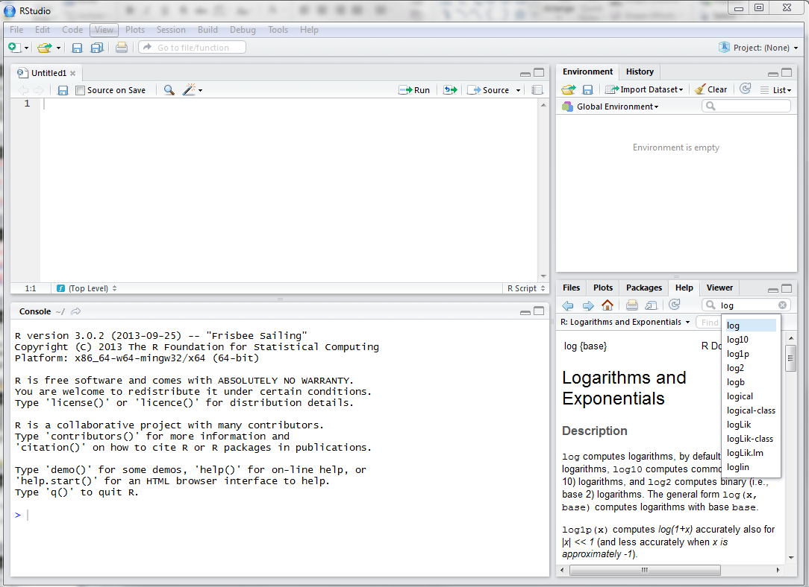
Help within R
Searching help:
help.search("logarithm")
Getting help with a function:
help(log)
?log
Can search for
help within RStudio

Slide 21
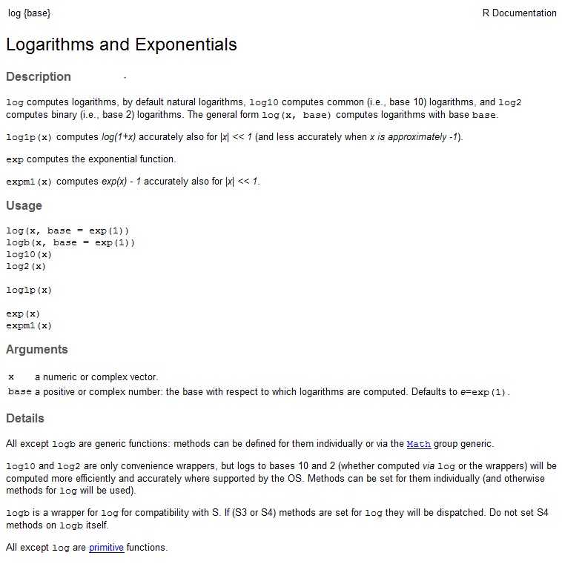
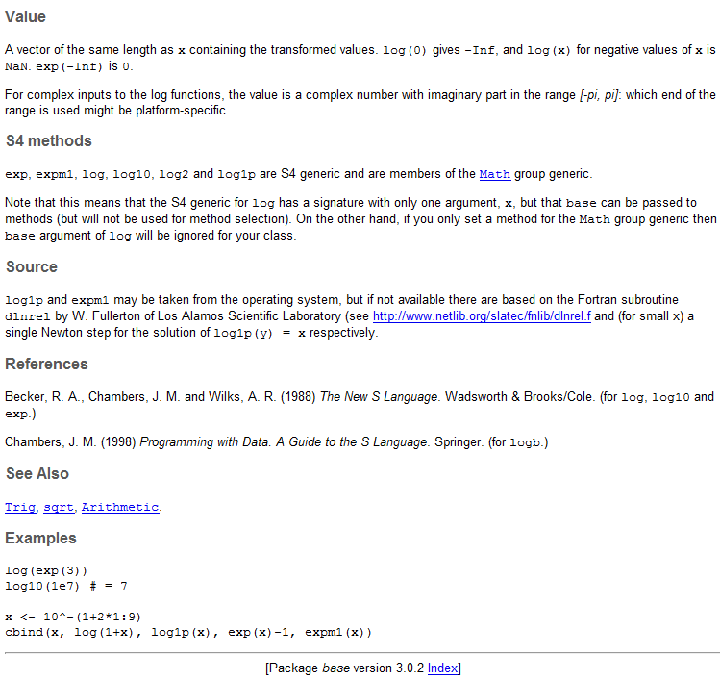
Help within R
The help file is broken down into several components: ?log

Slide 22
Assigning Values
Assign the value of log(2.718282) to a new object named answer
answer <- log(2.718282)
answer = log(2.718282)
answer = log(2.718282, base = 10)
= can be used instead of <-
Optional argument

Slide 23
Objects
Every programming outcome can be stored as an object
Numbers
Characters (strings or text)
Booleans (True / False)
Vectors/Matrices (ordered collection of numbers)
Tables (data frames)
Statistical output
Good names for objects are very important!
Objects in R are global
Notes:
23

Slide 24
Assigning Values
Characters may also be assigned to objects
> myName <- "Megan"
> myName <- 'Megan'
> (myName <- "Megan")
[1] "Megan"
Single or double quotes may be used for strings
Putting a command in parentheses will display the assigned object in the R Console

Slide 25
Viewing Objects
There are several ways to display the value of an object that has been assigned.
> print(myName)
[1] "Megan"
> answer
[1] 0.4342945
> answer*10
[1] 4.342945
manipulate an object

Slide 26
Vectors
A vector is an ordered collection of numbers
> x <- c(1,2,3)
> x
[1] 1 2 3
Use brackets [ ] to access elements of a vector
> x[3]
[1] 3
rep() replicates the values in x by a certain argument – default is times
> rep(x, length=10)
[1] 1 2 3 1 2 3 1 2 3 1
> rep(x, times=2)
[1] 1 2 3 1 2 3
seq() generates a sequence of values
> seq(from=0, to=10, by=2)
[1] 0 2 4 6 8 10

Slide 27
Vectors
Operations on vectors work element wise
> log(x)
[1] 0.0000000 0.6931472 1.0986123
> x + 1
[1] 2 3 4
> x * 2
[1] 2 4 6
> y <- 4:6
> x + y
[1] 5 7 9

Slide 28
Exercise 2
Create vectors using seq() and rep() and only c() if necessary
Positive integers from 1 to 99
Odd integers between 1 and 99
The numbers 3, 2, 1, 3, 2, 1, 3, 2

Slide 29
Exercise 2
Create vectors using seq() and rep() and only c() if necessary
Positive integers from 1 to 99
Odd integers between 1 and 99
The numbers 3, 2, 1, 3, 2, 1, 3, 2
> seq(from=1, to=99, by=1)
> seq(from=1, to=99, by=2)
> z <- c(3,2,1)
> z <- seq(from=3, to=1, by=-1)
> rep(z, length=8)

Slide 30
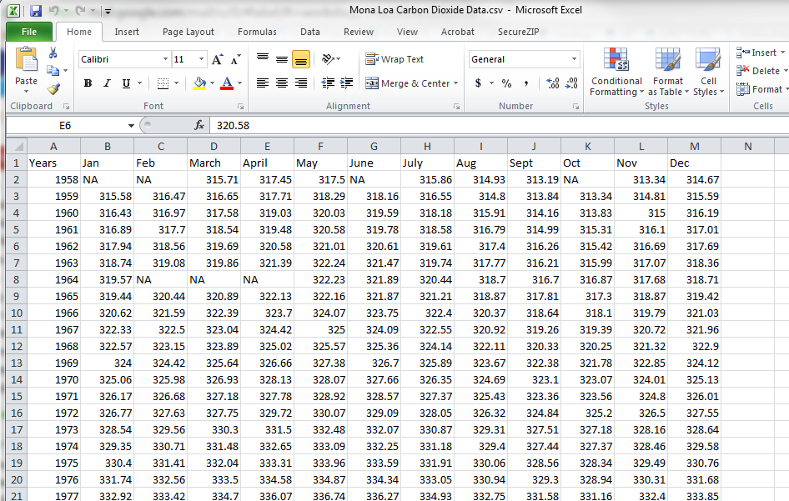
Importing data into R: preparing data
Can have row and column headers
Don’t include empty cells, use NA instead
Save as *.csv file

Slide 31
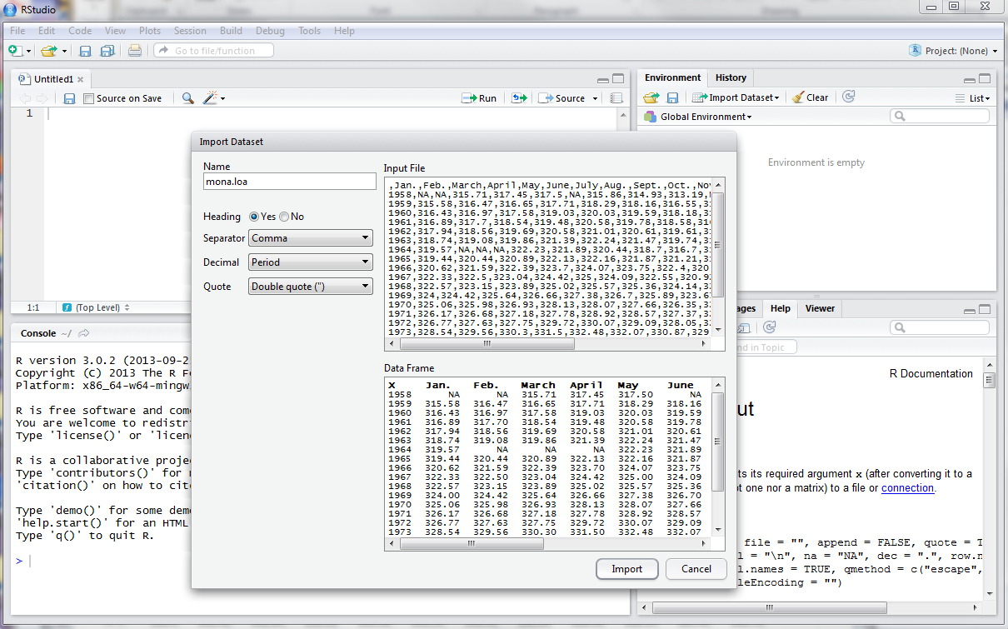
Importing data into R: point and click method
Click “Import Dataset” and navigate to file
Name to save object as

Slide 32
Importing data into R: setting working directory
Working directory tells R what folder to look in for the files you want to import
Use setwd() to set the working directory
When specifying address, use forward slashes (/) as separators. This is opposite to windows explorer which uses back slashes (\) as separators
> setwd("H:/R workshop/")
Use getwd() to see the current working directory
> getwd()
[1] "H:/R workshop"

Slide 33
Importing data into R: code method
Use the read.csv() function to read in comma separated data
Common options and defaults
file- file name, in quotes
header – first row has names for columns of data (TRUE)
row.names– vector of row names or number giving the column of the table which contains the row names
na.strings – what values are interpreted as NA (NA)
mona.loa <- read.csv("Mona Loa Carbon Dioxide Data.csv", header=TRUE)

Slide 34
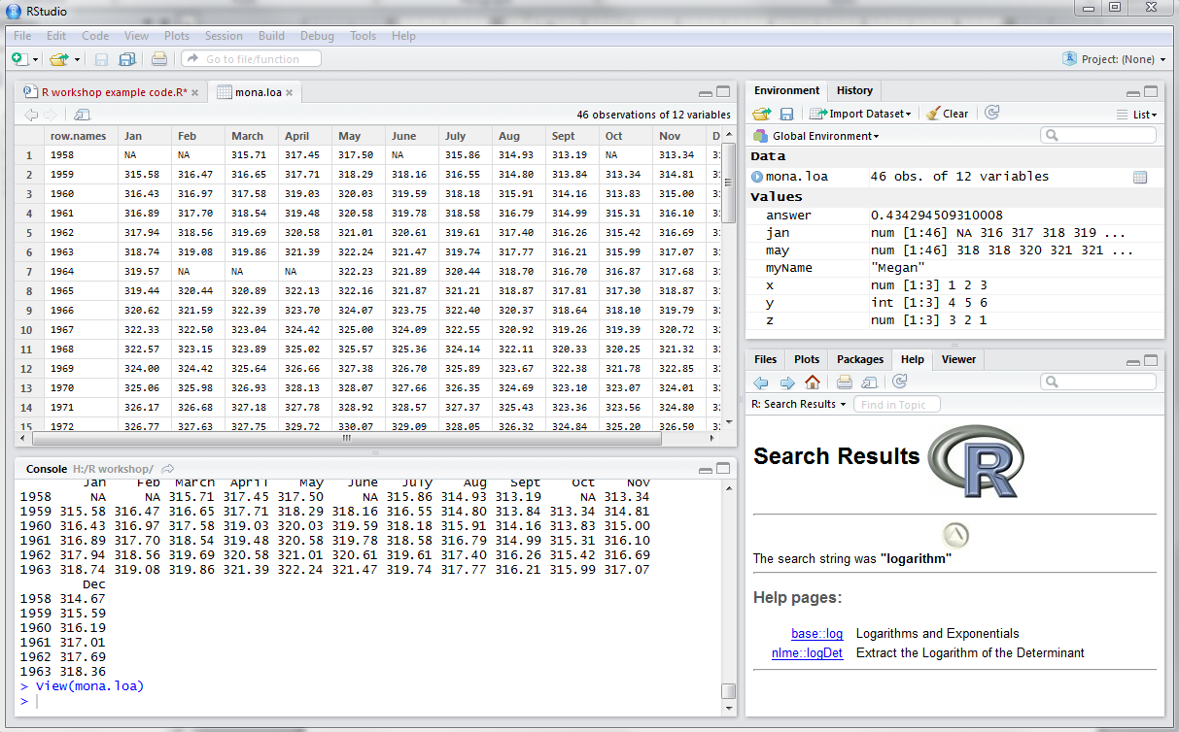
Viewing imported data
Click to view data

Slide 35
Data frames
A data frame is used for storing data tables. It is a list of vectors of equal length.
head() is quick way to view the first few observations of a data frame
> head(mona.loa)
Get the names of the data frame
> names(mona.loa)
Use the $ operator to extract variables from data frames
> may <- mona.loa$May

Slide 36
Useful arithmetic functions
> median(may)
[1] 342.185
> var(may)
[1] 338.6711
> sd(may)
[1] 18.40302
> range(may)
[1] 317.50 378.35
> length(may)
[1] 46
> min(may)
[1] 317.5
> max(may)
[1] 378.35
> mean(may)
[1] 343.8789
> quantile(may)
0% 25% 50% 75% 100%
317.5000 327.5525 342.1850 359.5800 378.3500

Slide 37
Linear regression
Model May Mona Loa values as a function of year
Different ways to specify the model:
> may.model <- lm(mona.loa$May~mona.loa$Years)
> may.model <- lm(May~Years, data=mona.loa)

Slide 38
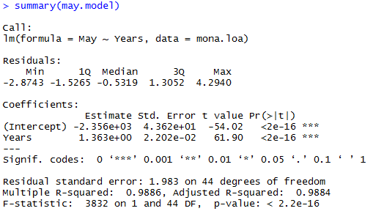
Linear regression
Use summary() to see the results of the model

Slide 39
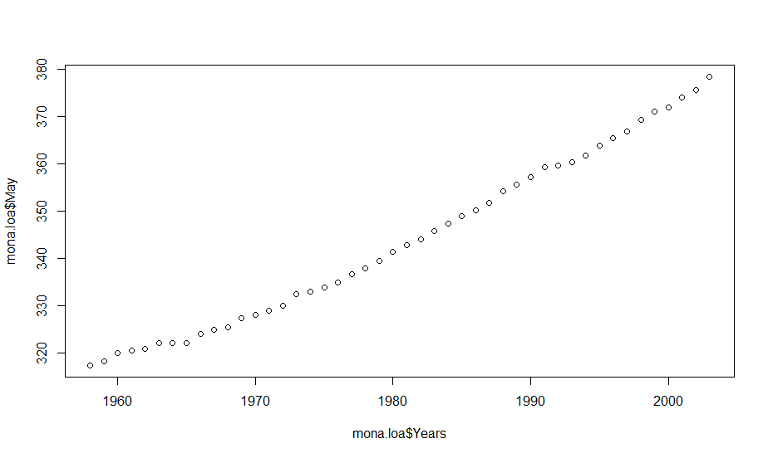
Plotting
plot() is the generic function for plotting R objects
> plot(x=mona.loa$Years, y=mona.loa$May)

Slide 40
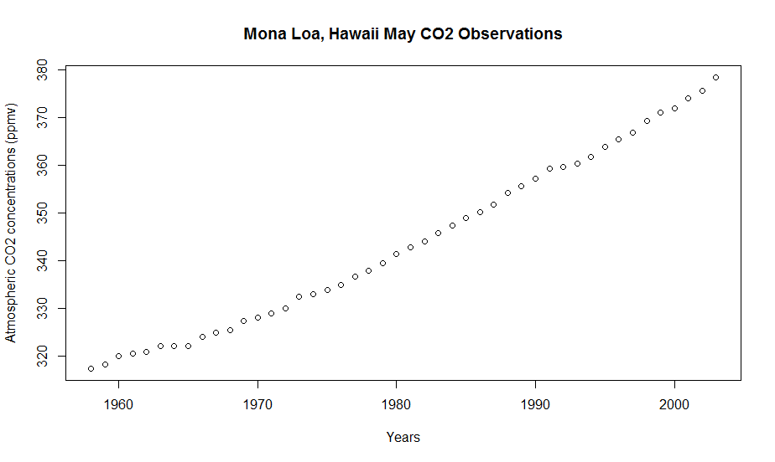
Plot with axis labels and title
By default, R will use the name of the variables as axis labels
Add x and y axis labels with the xlab and ylab arguments
Add title with the main argument
> plot(x=mona.loa$Years, y=mona.loa$May, xlab="Years", + ylab="Atmospheric CO2 concentrations (ppmv)",
+ main="Mona Loa, Hawaii May CO2 Observations")

Slide 41
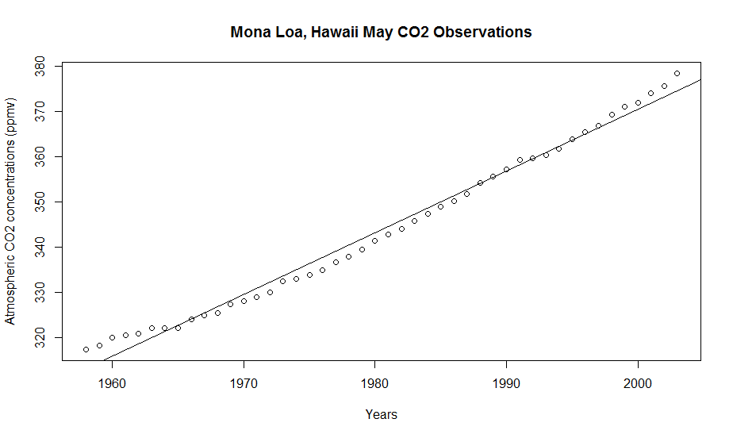
Add linear regression line
Add linear regression line with abline()
> abline(may.model)

Slide 42
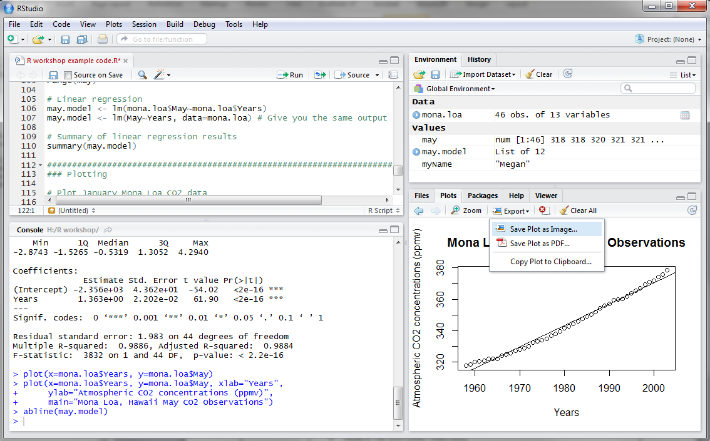
Saving plots: point and click in RStudio
Click “Export”

Slide 43
Saving plots: code
Useful if you want to save many plots
Many different formats available:
jpeg()
pdf()
png()
> jpeg("May Mona Loa CO2 Plot.jpg")
> plot(x=mona.loa$Years, y=mona.loa$May, xlab="Years",
+ ylab="Atmospheric CO2 concentrations (ppmv)",
+ main="Mona Loa, Hawaii May CO2 Observations")
> abline(may.model)
> dev.off()

Slide 44
Logic
Boolean (TRUE/FALSE) logic values
> rain <- c("Yes","Yes","No")
> rain == "Yes"
[1] TRUE TRUE FALSE
> rain != "No"
[1] TRUE TRUE FALSE
> rain == "No"
[1] FALSE FALSE TRUE

Slide 45
Logic
Boolean operators:
== Equal to
!= Not equal to
< Less than
> Greater than
<= Less than or equal to
>= Greater than or equal to
& And
| Or
! Not

Slide 46
Logic
The if() function can be used to do something only if a condition is met
Use curly braces { } to enclose what should be done if the condition is met
> snow <- "Yes"
> if(snow=="Yes"){
+ print("It's snowing")
+ }
[1] "It's snowing"
Conditional statement
What will happen if this is TRUE is within the curly braces { }

Slide 47
Logic
> nums <- c(12,9,8,14,7,16,3,2,9)
Are any numbers greater than 10?
> any(nums > 10)
[1] TRUE
Are all the numbers greater than 10?
> all(nums > 10)
[1] FALSE
Which numbers are greater than 10?
> which(nums > 10)
[1] 1 4 6

Slide 48
Loops
Use loops if you want to do the same task many times
> for(i in 1:5){
+ print(i)
+ }
[1] 1
[1] 2
[1] 3
[1] 4
[1] 5
Counter variable i
Values of the counter variable
Read “:” as “to”
What will happen for each value of i is within the curly braces { }

Slide 49
Loops
Make a plot for each month of Mona Loa CO2 data
pdf("Mona Loa CO2 Plots All Months.pdf")
for(i in 2:13){
plot(x=mona.loa$Years, y=mona.loa[,i], xlab="Years",
ylab="Atmospheric CO2 concentrations (ppmv)",
main=names(mona.loa)[i])
}
dev.off()
Data from column i
Plot title is the column name

Slide 50
R Learning and Reference Materials
“The R Book” by Crawley
An Introduction to R: http://cran.r-project.org/doc/manuals/R-intro.pdf; there are also manuals on other topics if you go to http://cran.r-project.org/ and click on the “Manuals” link on the left side of the page
R reference card: http://cran.r-project.org/doc/contrib/Short-refcard.pdf
Google- if you search google you’re likely to find an answer to your question. Since “R” is ambiguous, search “R CRAN” along with your question for the most relevant results.
R Seek- specific R search engine so you won’t get lost in other results like on Google: http://www.rseek.org/

